Slide 1

EXAM SEATING ARRANGEMENT
SRM Institute of Science and Technology
College of Engineering & Technology | School of Computing
Department of Computing Technologies
18CSC305J Artificial Intelligence – Mini Project
RA2111027010001 SETTEM VIJAY KUMAR
RA2111027010002 CHINTAPALLI DINESH
RA2111027010003 HARSHIT KUMAR
RA2111027010004 TARUSH CHINTALA

Slide 2
SOCIETAL BENEFIT
AI-powered seating optimization maximizes space utilization in exam halls, accommodating more students comfortably.
Fairness is ensured through impartial distribution of students, minimizing perceptions of favoritism in seating allocation.
Strategic placement using algorithms like N-Queen reduces cheating opportunities, upholding exam integrity.
Enhanced monitoring by proctors is facilitated, aiding in the identification and addressing of suspicious behavior during exams.
Analysis of seating arrangements yields valuable insights for institutions to optimize exam processes and improve learning outcomes.

Slide 3
PROBLEM STATEMENT
Manual seat assignment in exams poses challenges like time consumption, potential biases, and security risks.
Traditional methods often fail to optimize space usage and ensure fairness in seating allocation.
Proposed AI solution inspired by the N-Queen problem automates seating arrangements, addressing inefficiencies and security concerns.
The AI system generates optimal seating plans based on factors like student numbers, hall space, and special accommodations.
Prioritizing fairness and security, the solution aims to create equitable exam environments for all students.

Slide 4
OBJECTIVE WITH TECHNICAL DEPTH
UNDERSTANDING THE PROBLEM
Gain a clear understanding of the challenges associated with manual exam seating arrangements in educational institutions, including fairness, efficiency, and security concerns.
RESEARCH AND ANALYSIS
Conduct research on existing methods and technologies used for exam seating arrangements. Analyze the strengths and limitations of traditional approaches to identify areas for improvement.

Slide 5
OBJECTIVE WITH TECHNICAL DEPTH
CONCEPTUAL UNDERSTANDING OF N-QUEEN PROBLEM
Develop a conceptual understanding of the N-Queen problem and its relevance to the task of seating arrangement optimization.
ALGORITHM EXPLORATION
Explore different algorithms and strategies for solving the N-Queen problem. Understand the principles behind these algorithms

Slide 6
OBJECTIVE WITH TECHNICAL DEPTH
SOFTWARE DEVELOPMENT SKILLS
Acquire programming skills necessary for developing a software application to automate exam seating arrangements. Familiarize yourself with programming languages such as Python.
IMPLEMENTATION PRACTICE
Practice implementing algorithms and data structures relevant to the project, such as arrays, matrices, and graph representations. Develop proficiency in translating algorithmic concepts into code to solve practical problems.

Slide 7
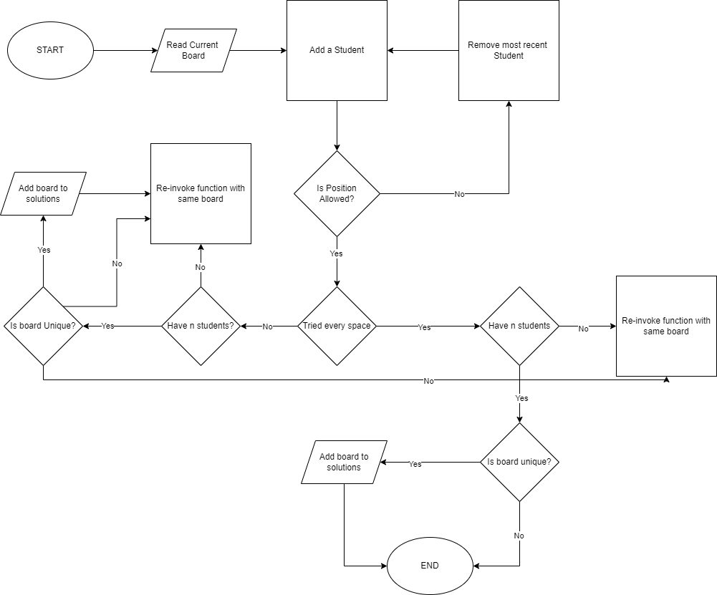
PROPOSED WORKFLOW

Slide 8
PROPOSED WORKFLOW
Problem Statement
Arrange N students in a seating arrangement to prevent cheating during exams.
Understanding the N-Queens Problem
Adapt the N-Queens problem to seating arrangement constraints.
Algorithm Design
Initialize seating arrangement.
Apply constraint satisfaction to avoid cheating opportunities.
Utilize backtracking for exploring valid solutions.
Validate final seating arrangement.

Slide 9
PROPOSED WORKFLOW
Implementation
Use suitable programming language such as Python.
Implement data structures and algorithms such Backtracking.
Presentation of code snippets for clarity.
Testing and Evaluation
Testing with various scenarios.
Measuring execution time.
Evaluation of solution effectiveness.
Optimization Strategies
Discussing methods for improving algorithm efficiency.
Considering trade-offs between speed and solution quality.

Slide 10
PROPOSED WORKFLOW
Real-World Applications
Exploring practical applications beyond exams.
Highlighting relevance to real-world scenarios.
Conclusion
Summarizing key achievements.
Discussing project implications.
Suggesting future research directions.

Slide 11
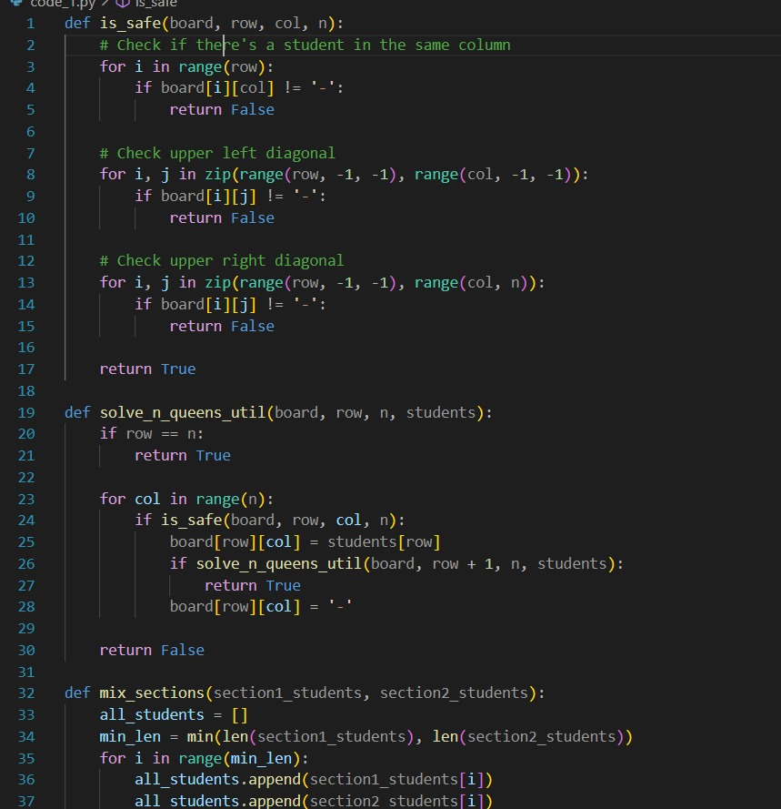
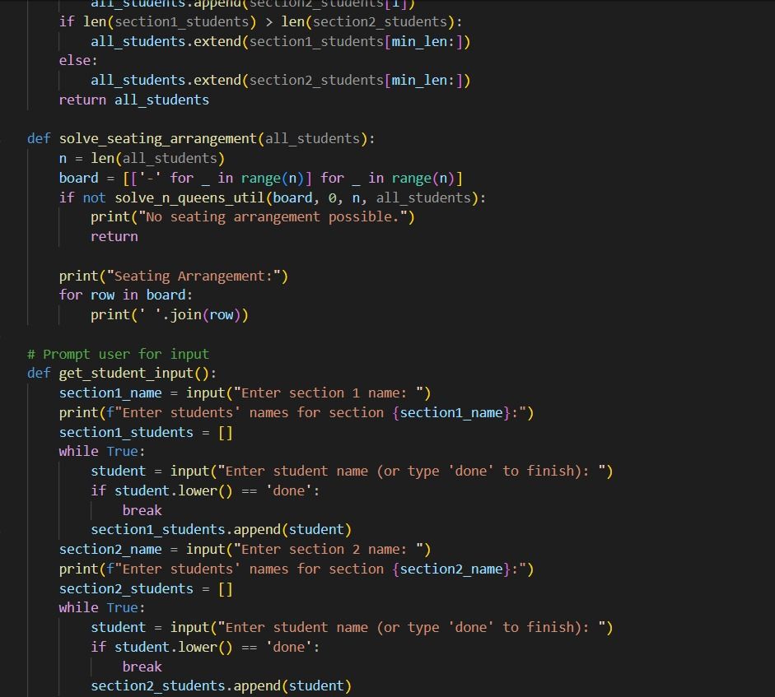
IMPLEMENTATION
CODE:-

Slide 12
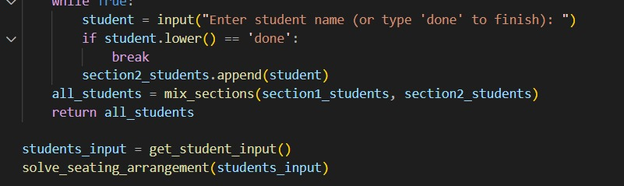
IMPLEMENTATION
CODE:-

Slide 13
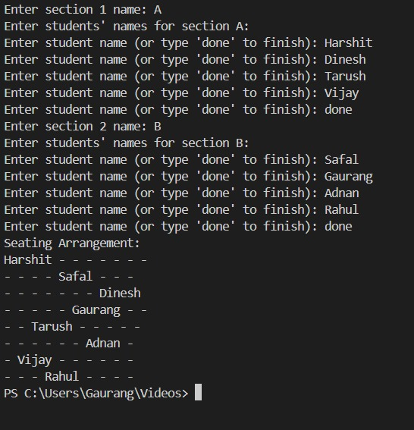
IMPLEMENTATION
OUTPUT:-

Slide 14


